Slide 1
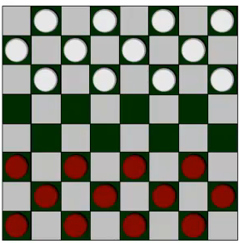
What’s machine learning
Machine Learning definition
Arthur Samuel(1959). Machine Learning: Field of study that gives computers the ability to learn without being explicitly programmed.

Slide 2
Tom Mitchell(1998). Well-posed Learning Problem: A computer program is said to learn from experience E with respect to some class of tasks T and performance measure P, if its performance at tasks in T, as measured by P, improves with experience E.

Slide 3
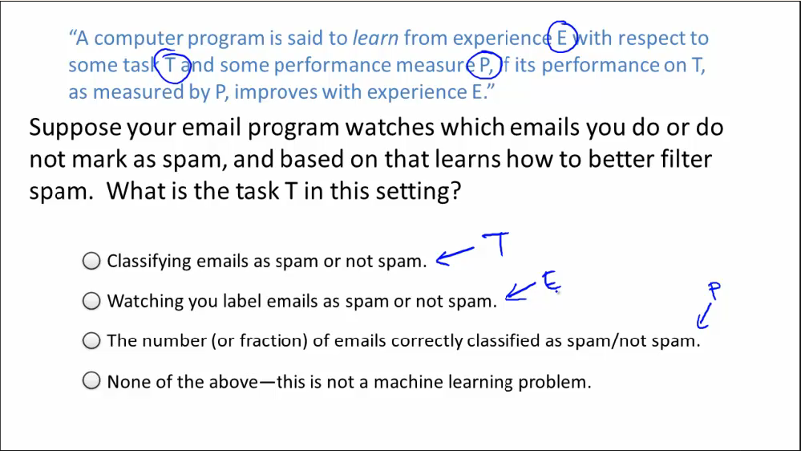

Slide 4
Machine learning algorithms:
Supervised learning——teach the program how to do something
Unsupervised learning——let it learn by itself
Others:
Reinforcement learning（强化学习）
recommender systems（推荐系统）

Slide 5
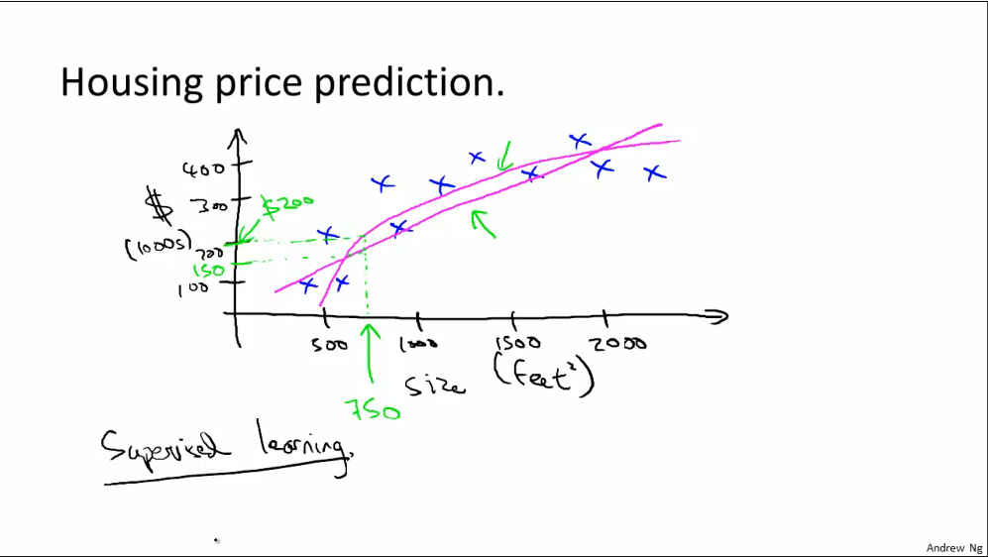
Supervised Learning
In supervised learning, the algorithm is given data in which it is told the “correct answer” for each example

Slide 6
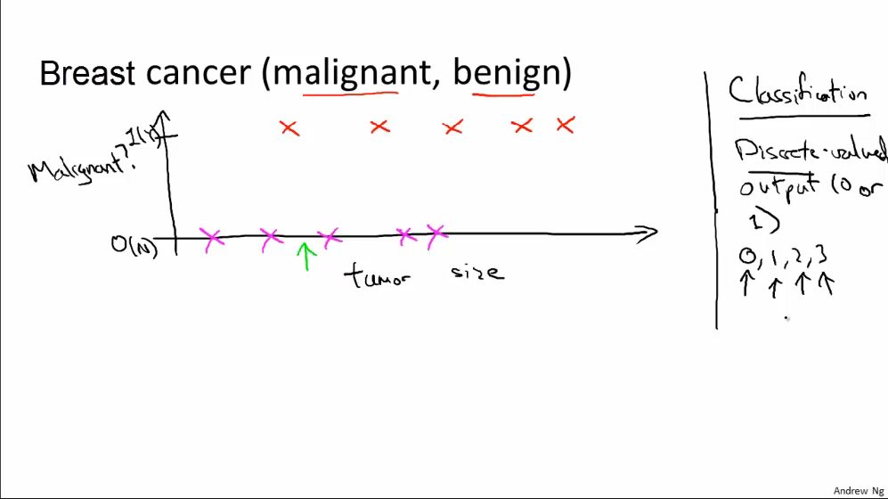
Classification problem

Slide 7
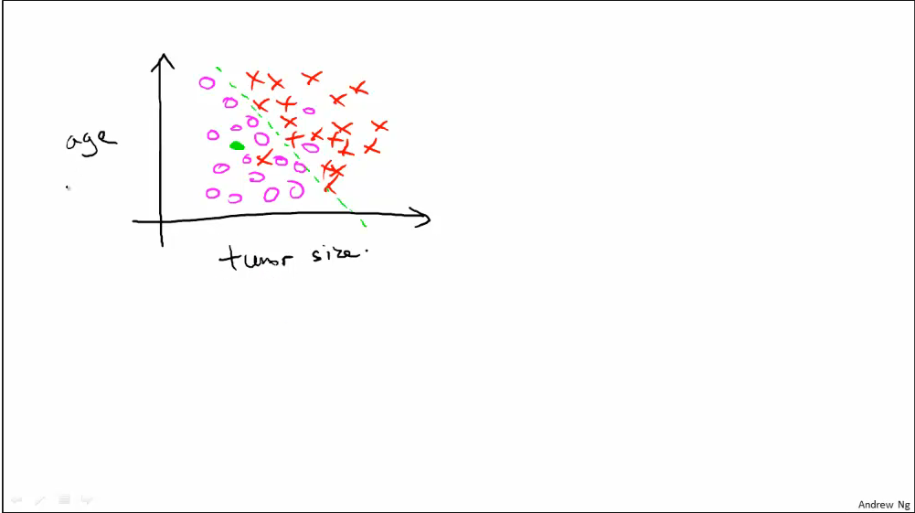

Slide 8
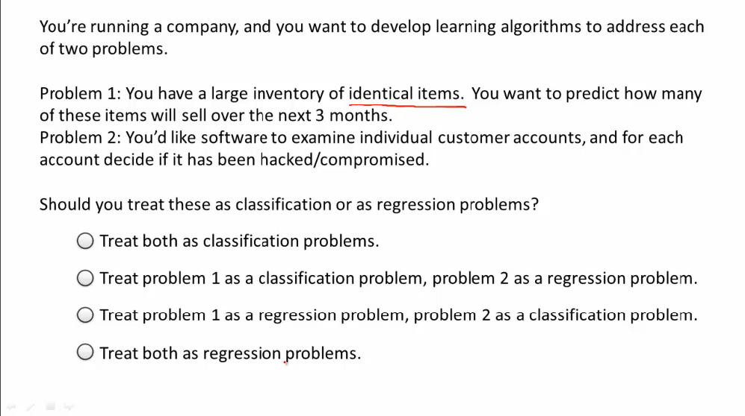

Slide 9
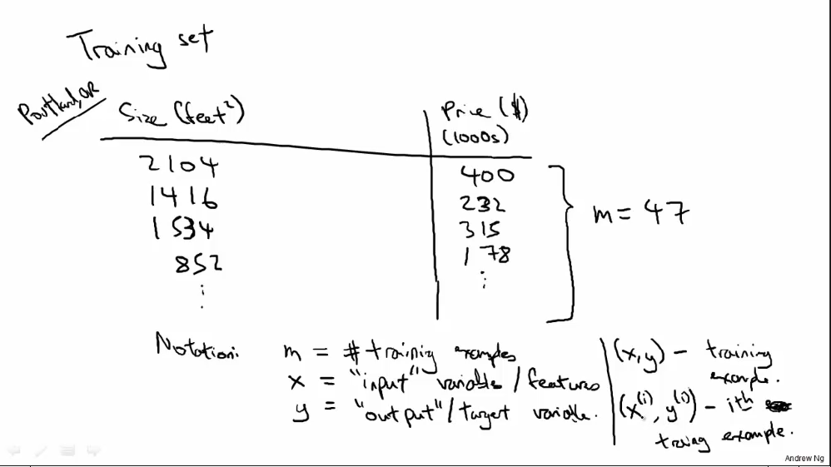
Linear Regression I: Model representation

Slide 10
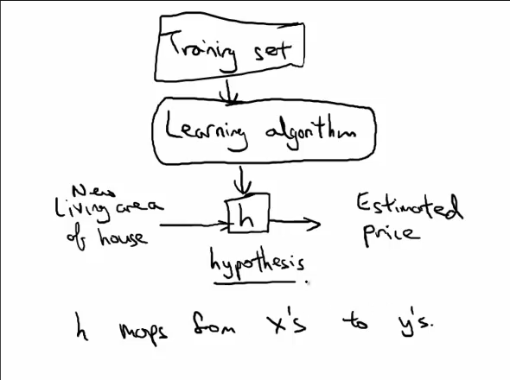


Slide 11
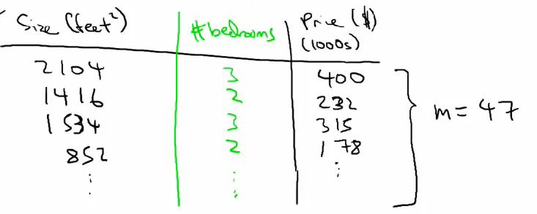
When we knows more features, such as the number of the bedrooms

Slide 12
Linear regression
For conciseness, define
Define

Slide 13
Cost Function
Cost function:
——ith training example
When we choose parameters ,we minimize our cost function

Slide 14
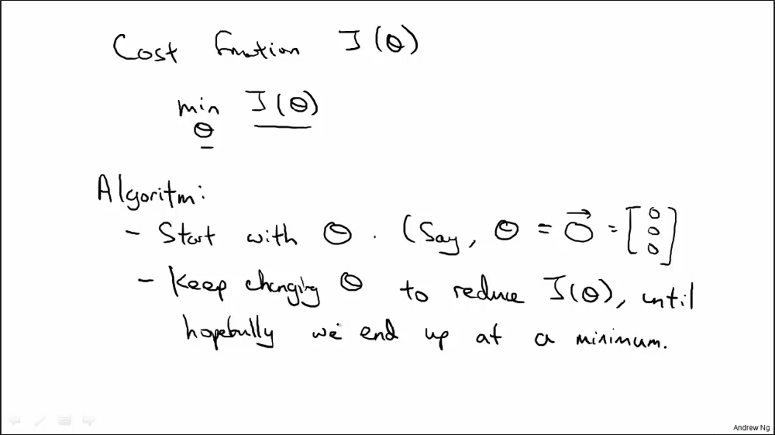
Gradient descent

Slide 15
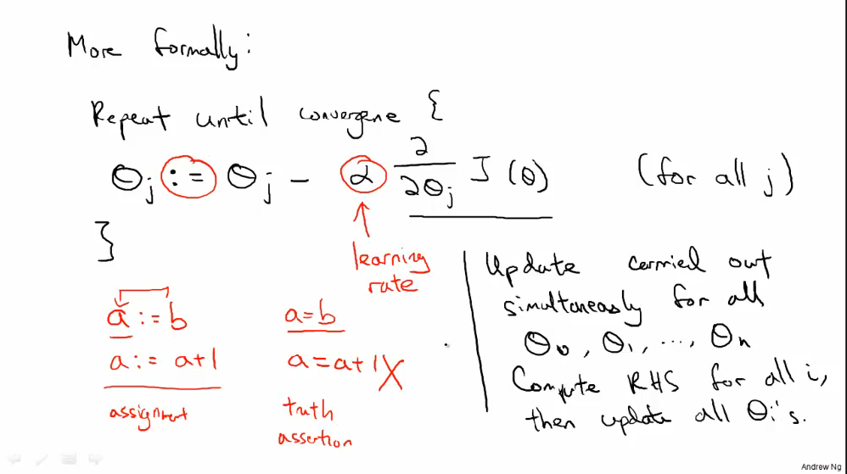

Slide 16
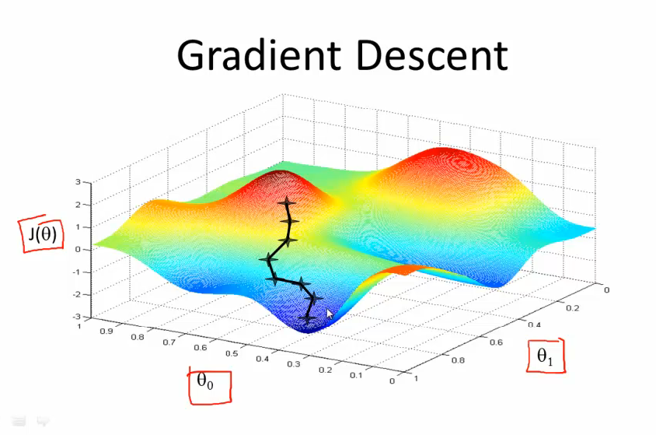

Slide 17
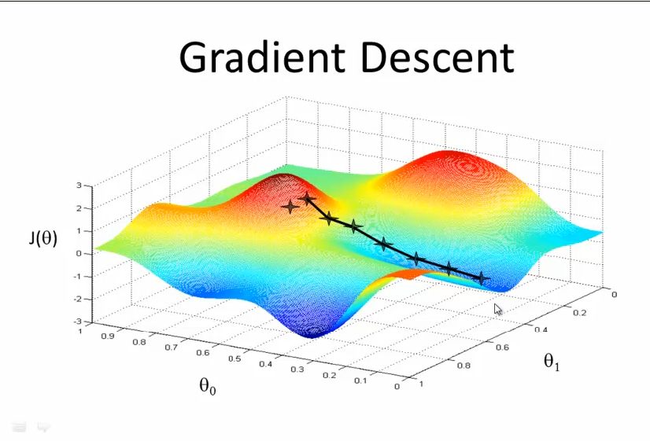

Slide 18
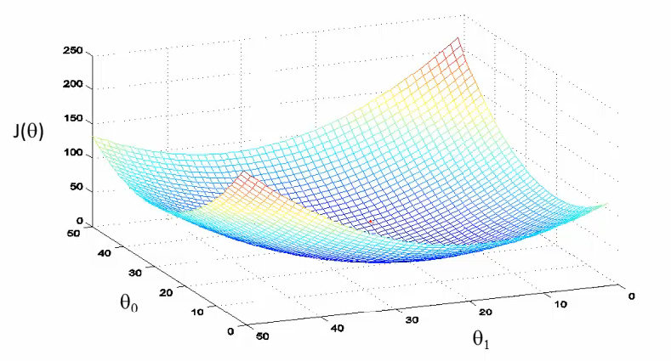
Let’s see how the gradient descent works when we apply it to linear regression?
The cost function of linear regression always looks like a big bowl shape, only have a global optimum down here at the bottom.

Slide 19
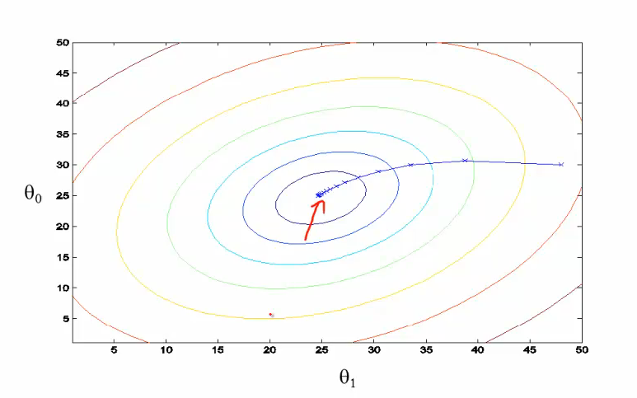

Slide 20
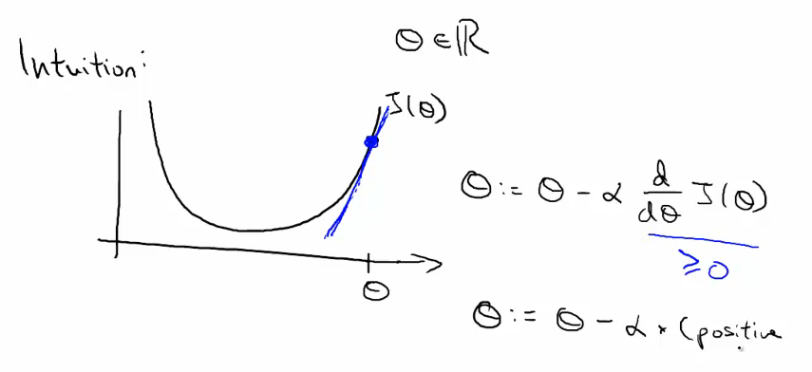
How gradient descent can converge to local minimum even with learning rate α fixed?
As we approach a local minimum, gradient descent will automatically take smaller steps. So, no need to decrease α over time to get gradient descent to converge.

Slide 21
α (learning rate) controls the “step size”:
If α is too small , gradient descent can be slow
If α is too large , it will overshoot the minimum, gradient descent can diverge.

Slide 22
Gradient Descent for Linear Regression
Linear regression:
hypothesis
cost function
Gradient descent:
repeat until converge

Slide 23
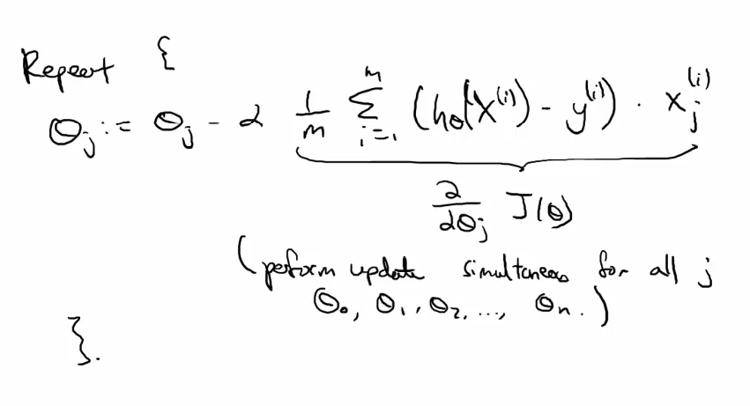

Slide 24
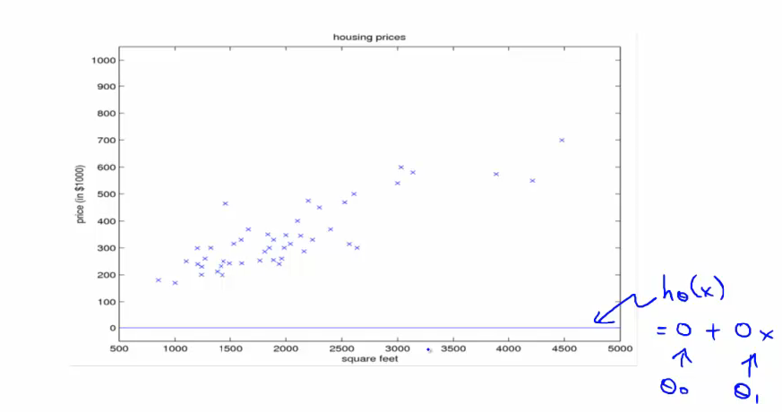

Slide 25
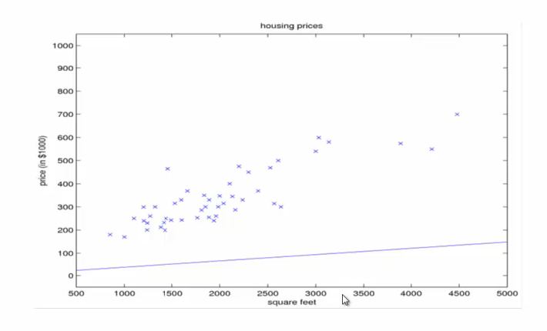

Slide 26
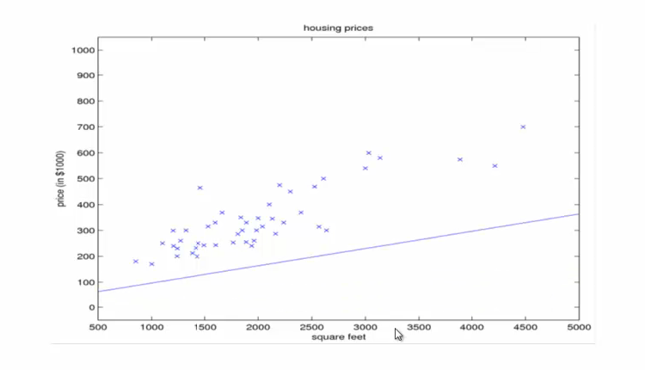

Slide 27
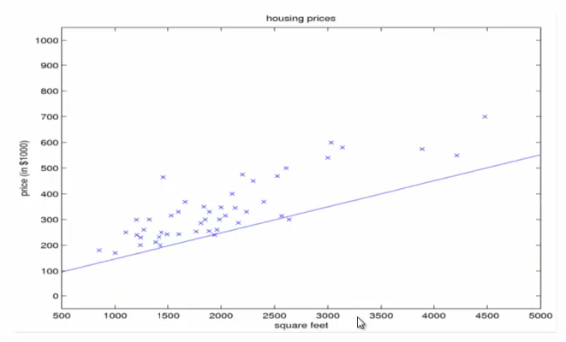

Slide 28
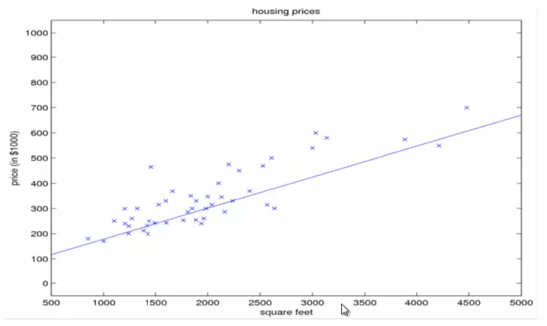

Slide 29
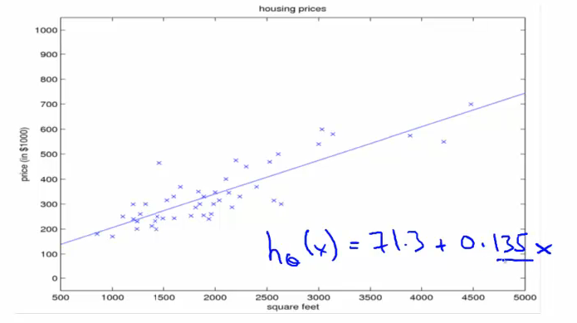

Slide 30
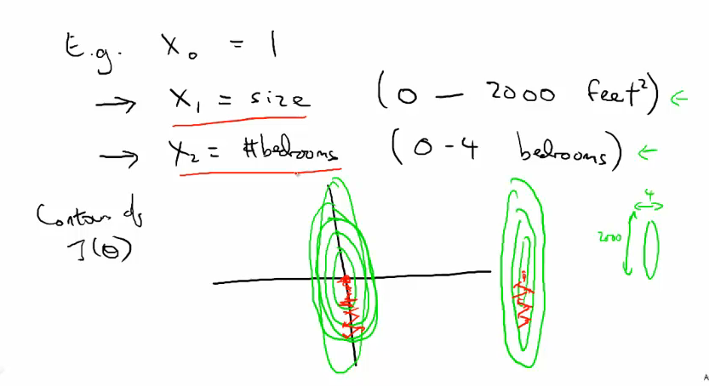
Feature Scaling
Make sure features on similar scales!

Slide 31
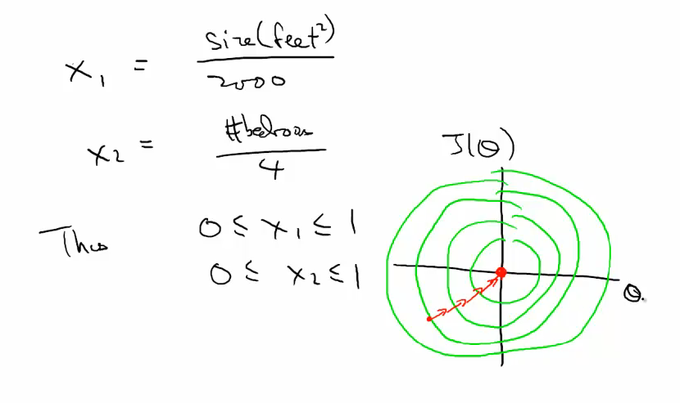
Don’t worry if all features have exactly the same range, so long as the roughly comparable, it should be OK.

Slide 32
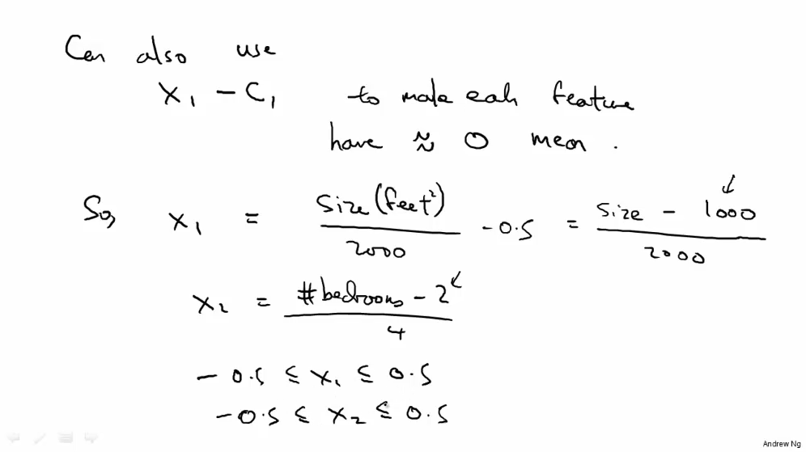
Can also use x1-c1 to make each feature have approximately zero mean.

Slide 33
: average size in training set
: average the number of bedrooms
: Capture the range of the data
(deviation of the size)

Slide 34
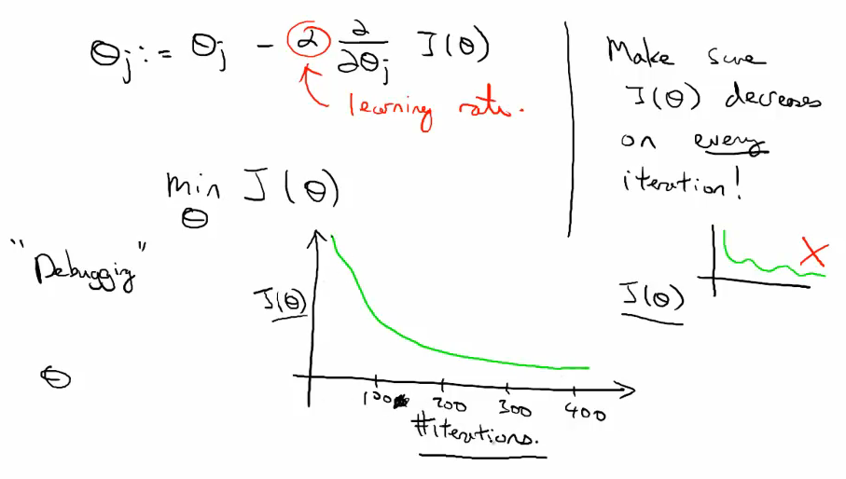
Learning rate
How to choose the learning rate alpha for gradient descent, talk about debuggingmake sure the gradient descent working probably.

Slide 35
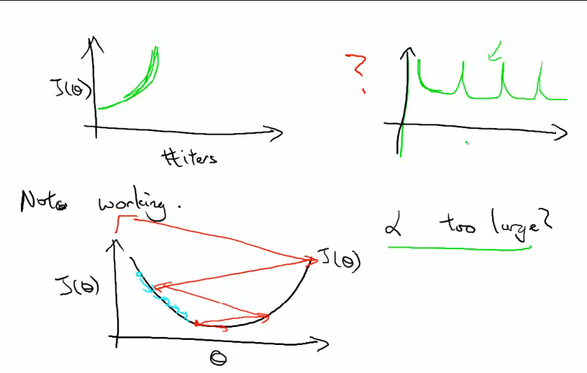

Slide 36
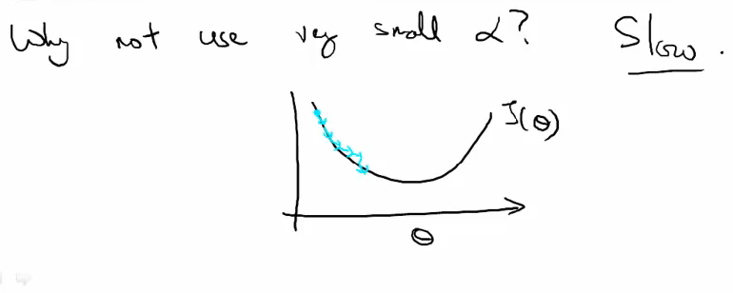
For sufficiently small learning rate alpha, J of theta should decrease ( or stay same ) on every iteration. If learning rate is too small, gradient descent will be too slow.

Slide 37
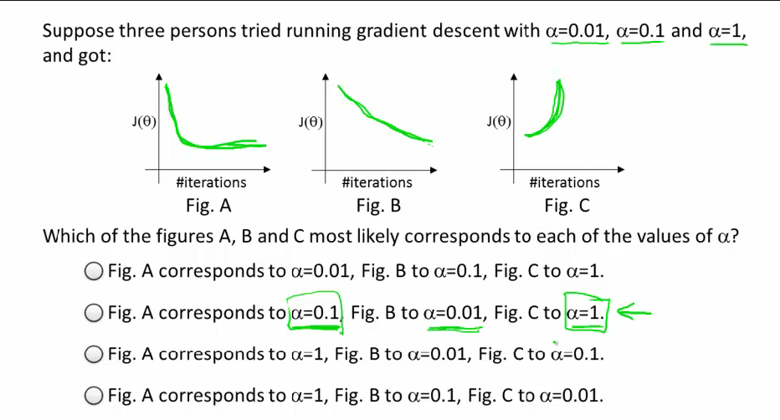

Slide 38
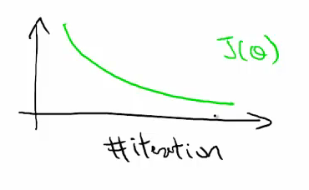
When implementing gradient descent, a good practice is to plot J of theta as a function of iterations, verify it always decreases in every iteration, both help you figure out the learning too small or too large, and help you verify the gradient descent correctly.

Slide 39
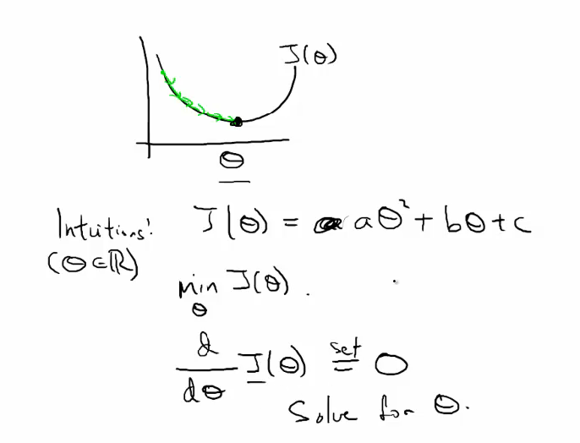
normal equation

Slide 40
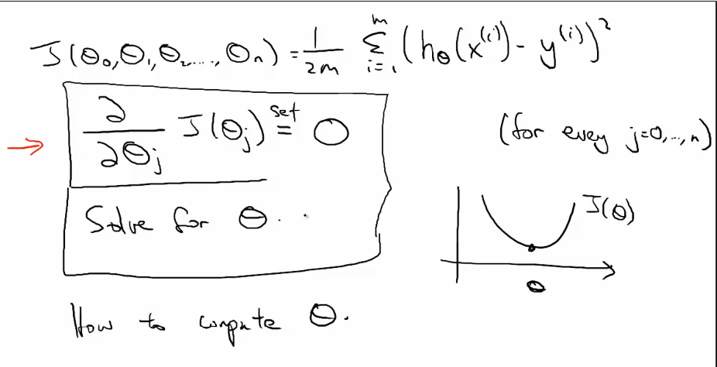

Slide 41
假设我们有m个examples（训练样本），
n个features（特征）
首先计算design matrix

Slide 42
当n=1时，
The solution of

Slide 43
If is non-invertible matrix(singular matrix), there are two causes:
Too many features(e.g. ) ——you need to use regularization, or delete some features
Have redundant features(linear dependent features)——get rid of redundancy
Normal equation is the name of the method we use to solve
When we use normal equation to solve the data, we don’t need to worry about the scale of the data, we don’t need to rescale the features.

Slide 44
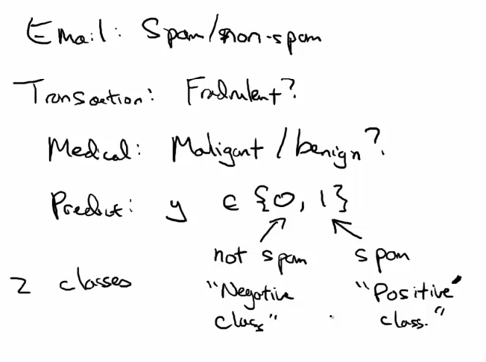
Logistic regression : Classification

Slide 45
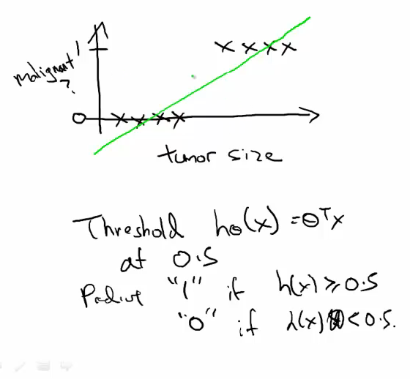

Slide 46
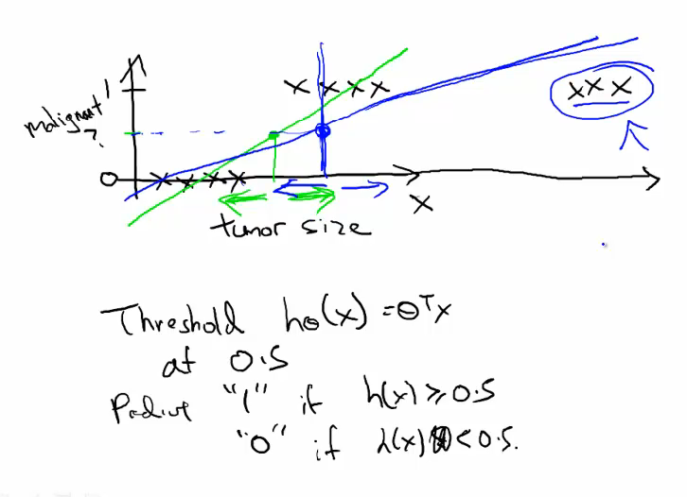
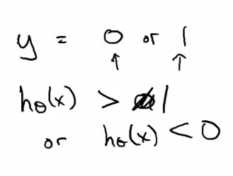

Slide 47
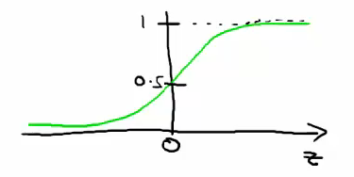
Logistic regression : Model
We have class labels , we want a classifier, and How to represent the hypothesis?
In particular
the output value between 0 and 1
called sigmoid function or logistic function

Slide 48
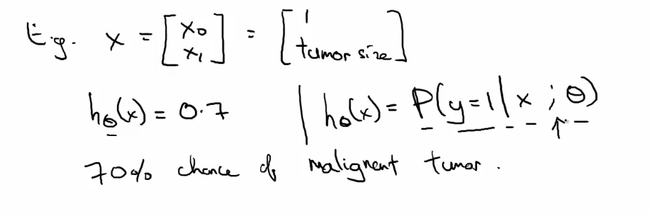
Talk about more interpretation about the output of the model
The output of the model
= the estimate of the probability that y=1 for a given x

Slide 49
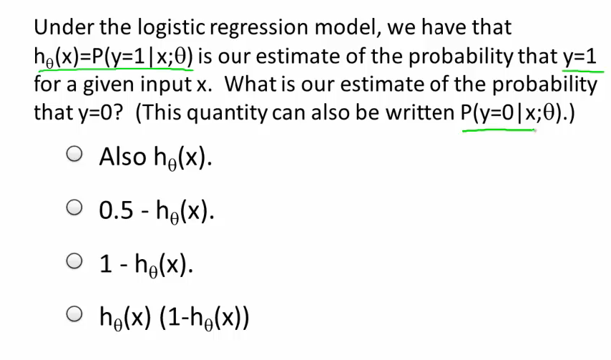
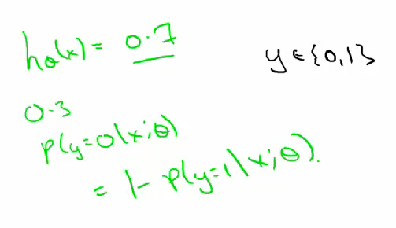

Slide 50
Logistic Regression : Optimization Objective I
Training set(m training examples) :
Features:

Slide 51
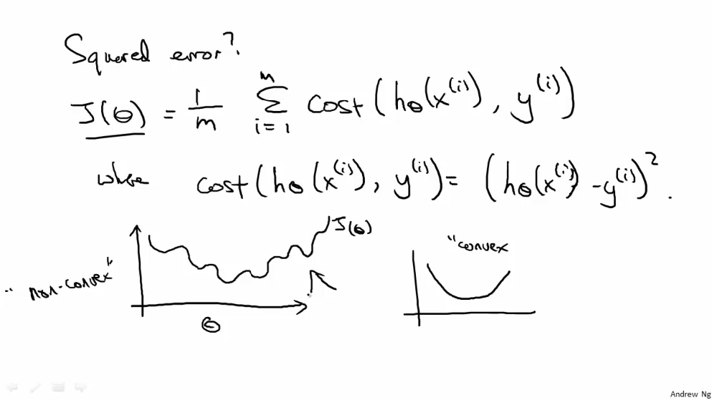
How to choose or fit the parameters θ to our training set?

Slide 52
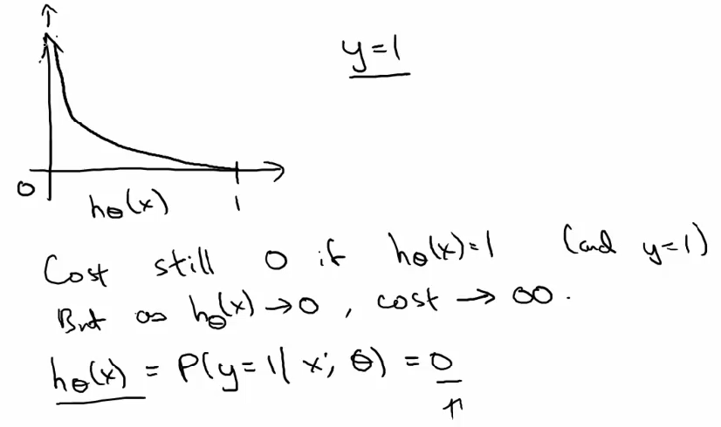

Slide 53
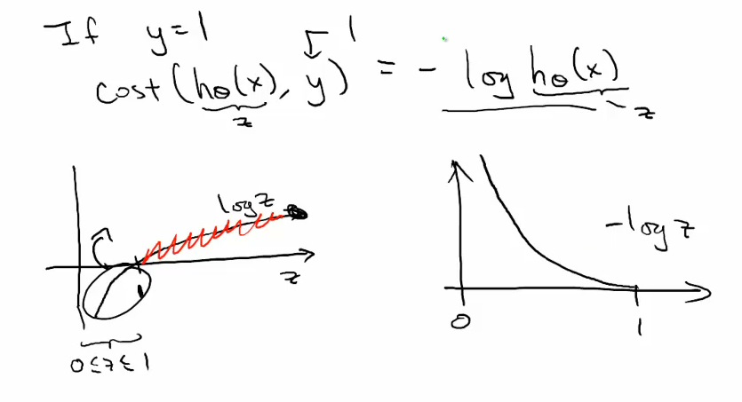

Slide 54
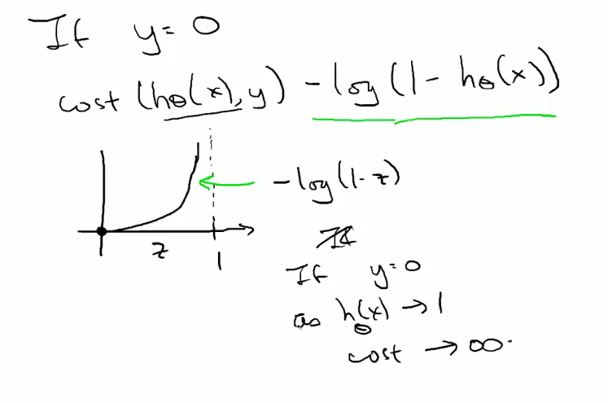

Slide 55
Logistic Regression : Optimization Objective II
Assume y always equals 0 or 1.

Slide 56
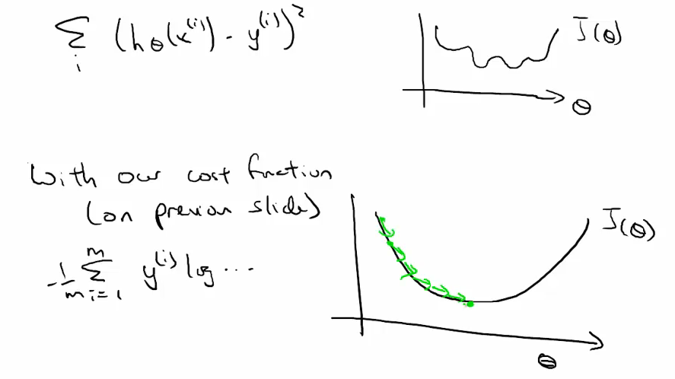

Slide 57
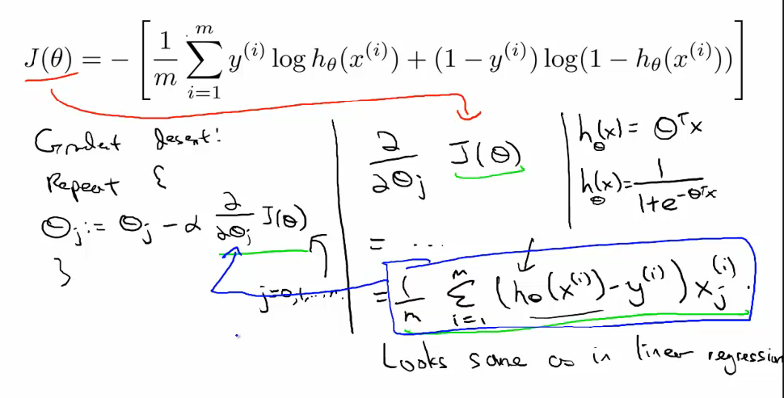
Logistic Regression : Gradient Descent

Slide 58
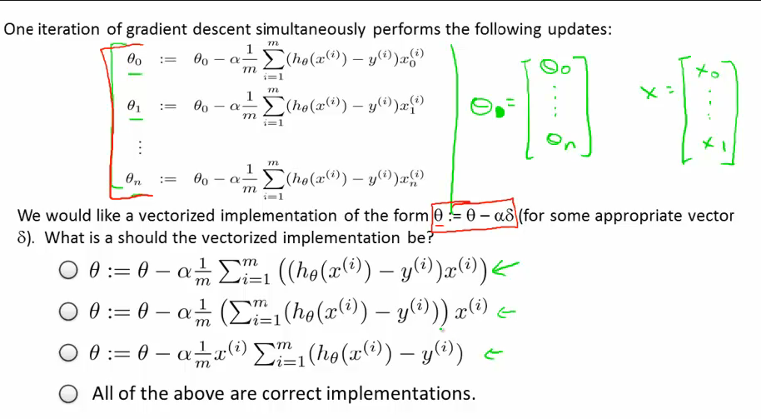

Slide 59
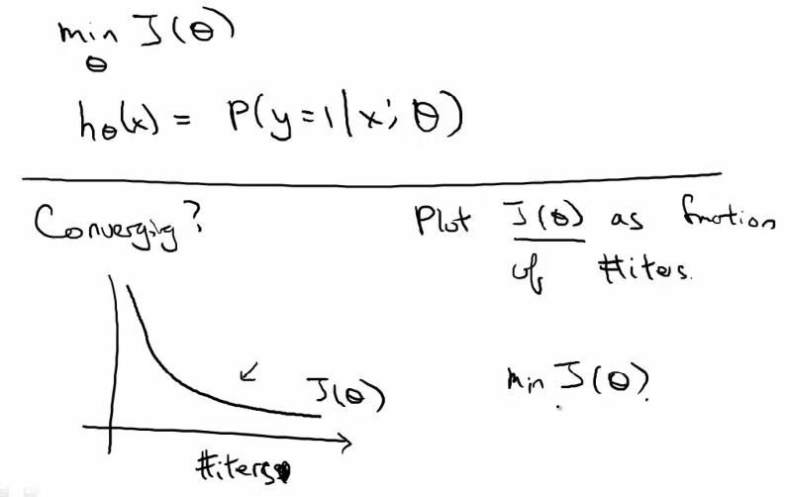
How to figure out if gradient descent is converging?
Plot as a function of the number of iterations
help you check if the gradient descent is converging

Slide 60
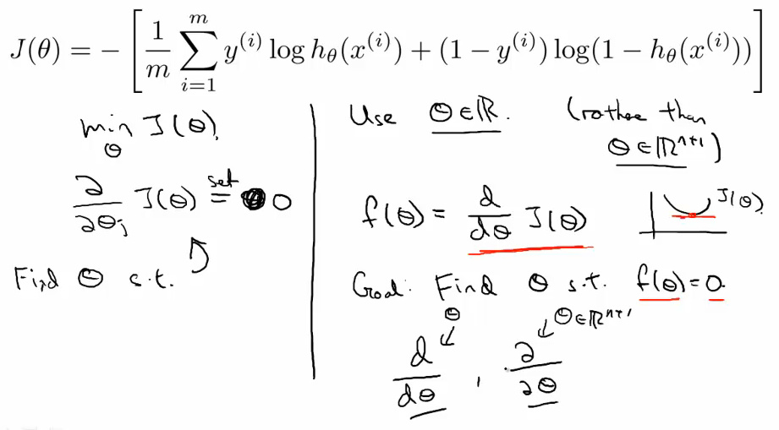
Logistic Regression : Newton’s Method

Slide 61


Slide 62

More details of algorithm for one iteration of the method

Slide 63
General form
One iteration in Newton’s method

Slide 64
Logistic Regression : Newton’s Method II
When θ is a raw number
When θ is a vector of parameter
H is called Hessian matrix of J

Slide 65


Slide 66
This is one iteration of Newton’s method

Slide 67


Slide 68

Fit a quadratic function and match the function of first derivative at the point, then minimize the quadratic function….At last, end up at the purple point, maybe it is not exactly, but is very close to the minimum.

Slide 69
This algorithm converges extremely quickly, especially when your optimization function J of theta is convex.

Slide 70


Slide 71

Logistic Regression : Gradient Descent vs Newton’s Method

Slide 72

Even though gradient descent needs more iterations to converge, it turns out each iteration is cheap, each iteration cost O(n), n=#features
For contrast, in Newton’s method, each iteration is more expensive. In particular, you need to take Hessian matrix H, which is a (n+1)*(n+1) matrix, the cost of inverting matrix is roughly equals to O( )

Slide 73

If n is small, means small number features, and the cost of per iteration will not be too much, and Newton’s method may be preferable.
When n is large, then the cost of per iteration is not much cheaper, then gradient descent may be preferable.
What’s large mean?

